Slide 1

How to write a scientific article for publication on reputable international journal
Menulis Publikasi di Jurnal yang Tepat
Rino R. Mukti
Institut Teknologi Bandung
World Class Professor Program
Depok, 23 September 2019

Slide 2
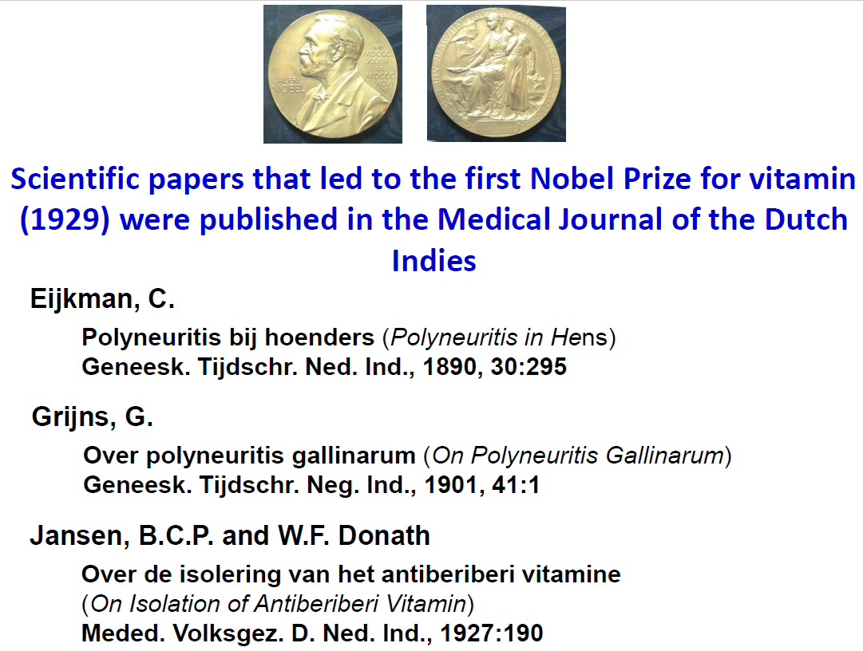
Slide from Prof. Sangkot Marzuki

Slide 3
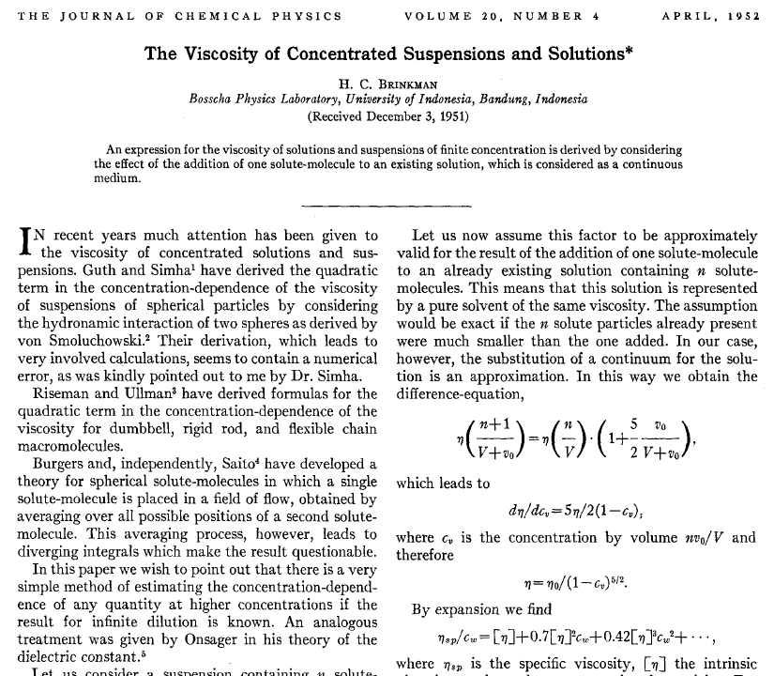
Bosscha Physics Laboratory-UI,Bandung

Slide 4
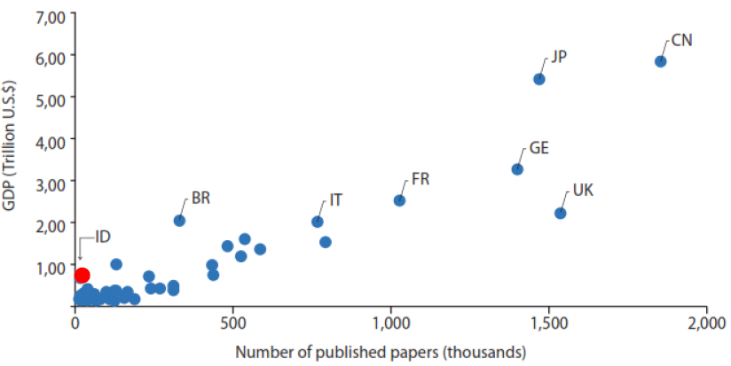
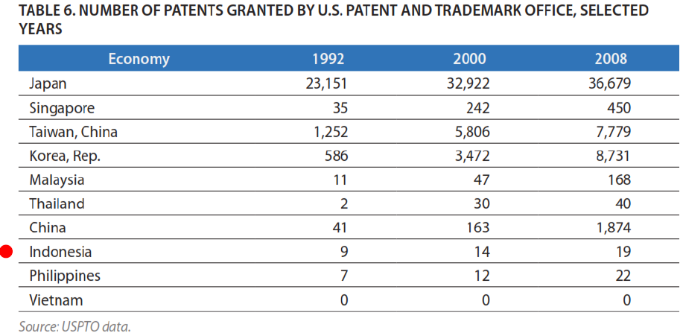
Indonesia does not produce knowledge nor technology as it should
Slide from Prof. Sangkot Marzuki

Slide 5
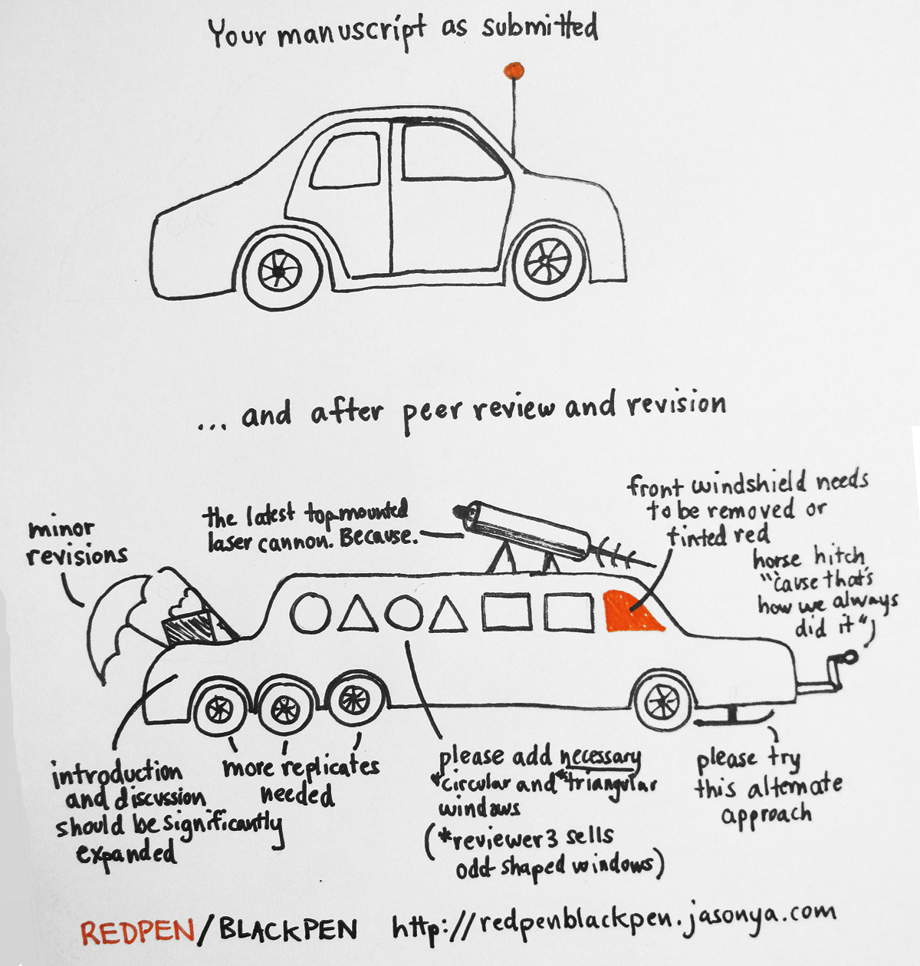
Research
Research is an ORGANIZED and SYSTEMATIC way of FINDING ANSWERS to QUESTIONS.
The outcome of research is written and published on reputable journals.
Illustration on how to prepare a manuscript and the final revised manuscript.

Slide 6
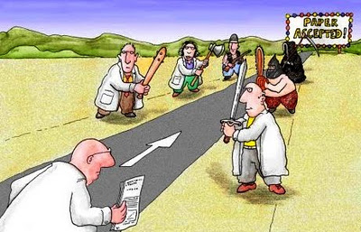
The long and winding road for publishing paper
http://www.phd2published.com

Slide 7
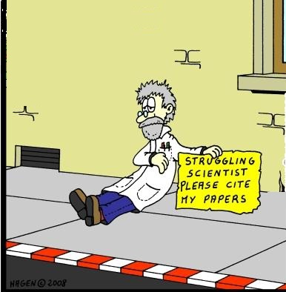
https://educationwritinghelp.wordpress.com

Slide 8

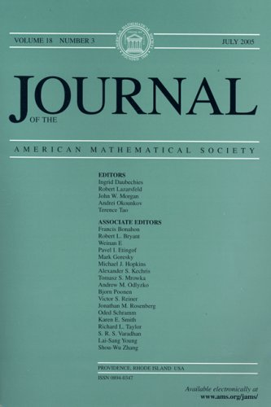

Slide 10
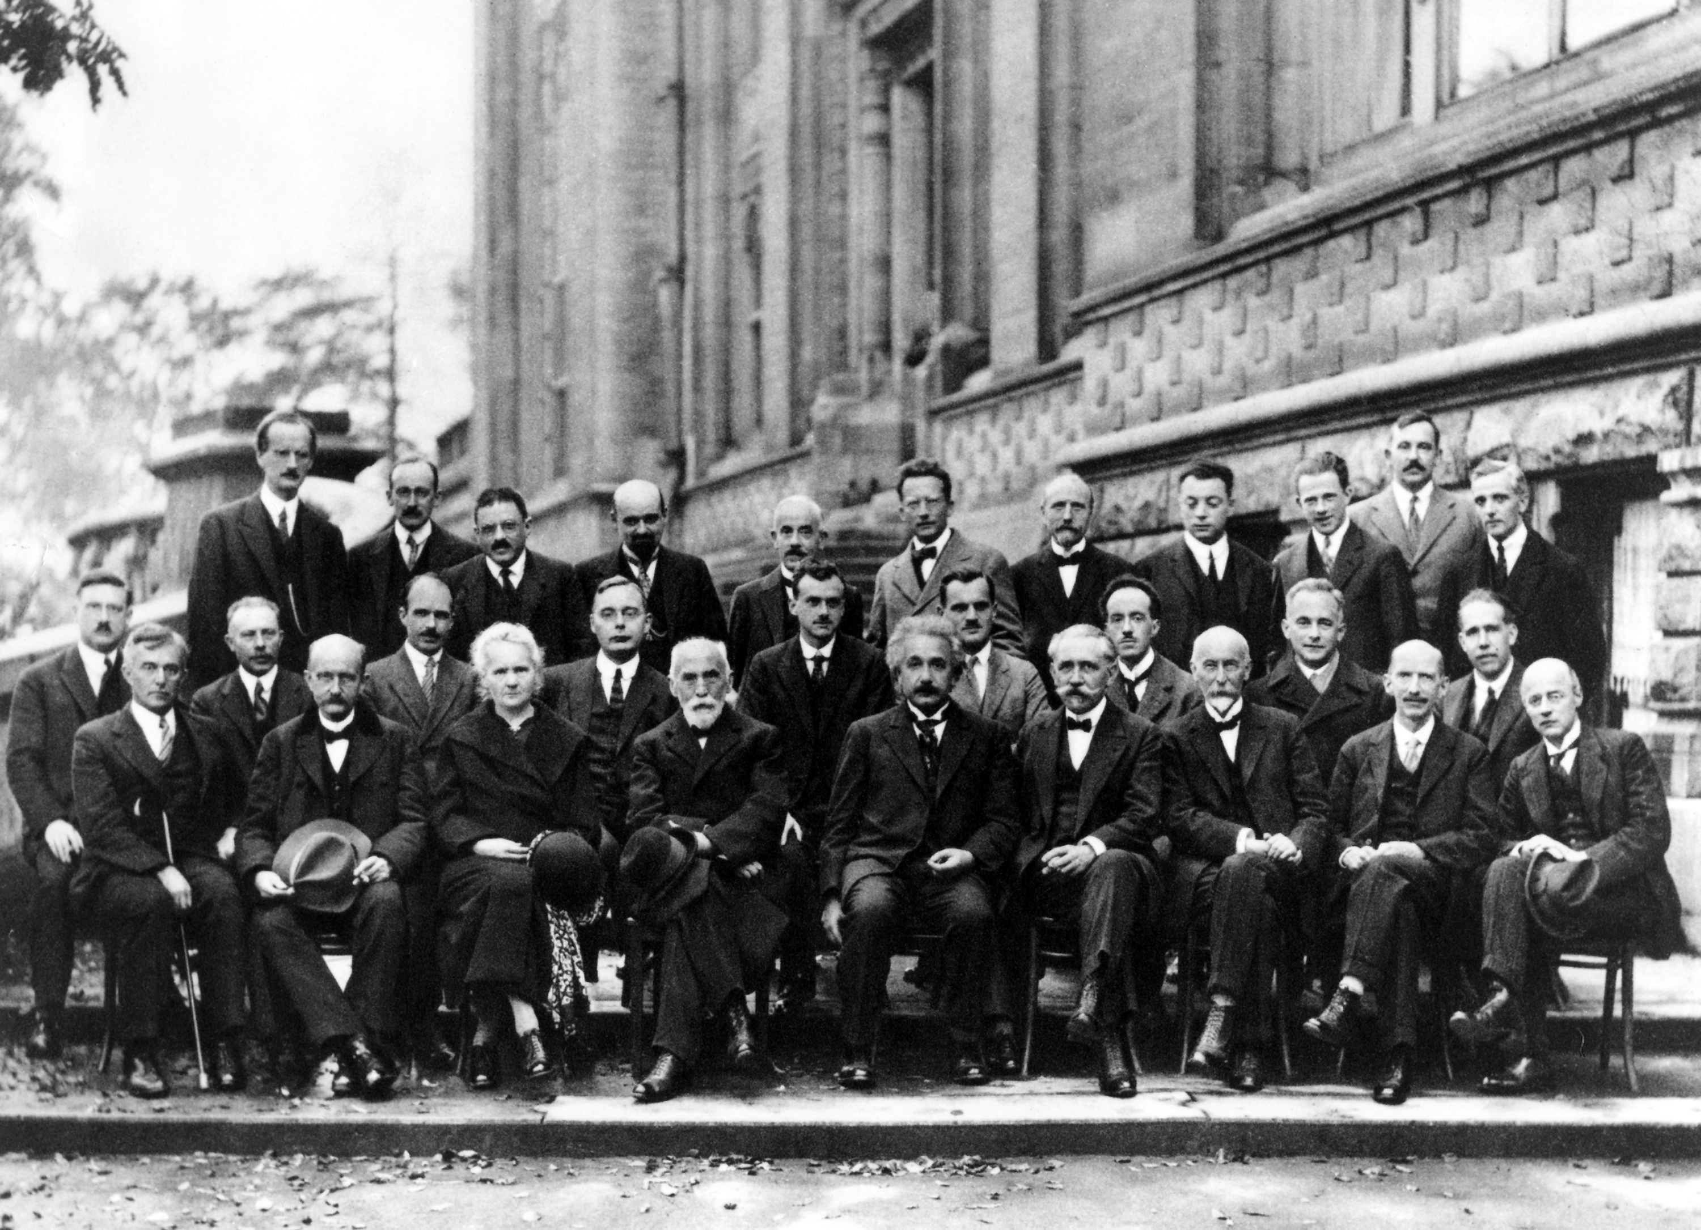

Slide 12
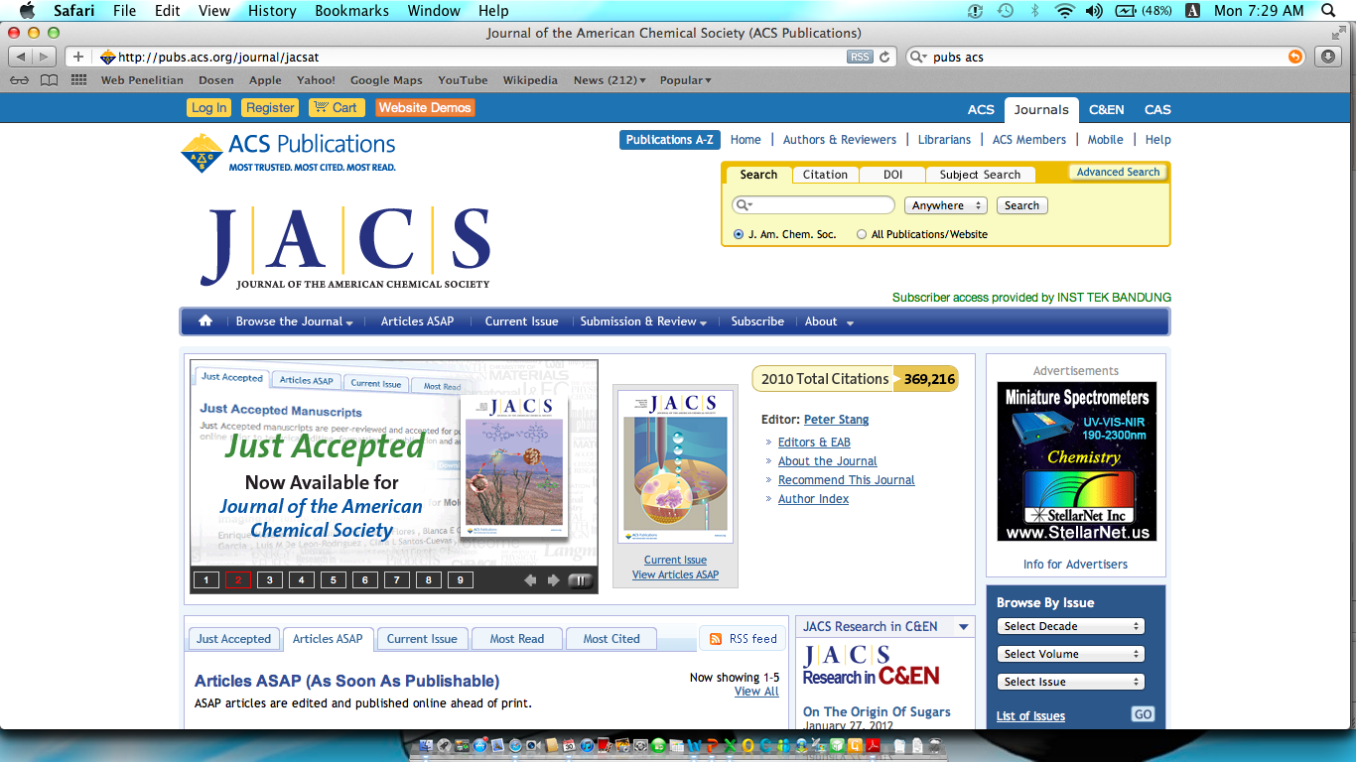
Journal of the American Chemical Society

Slide 13
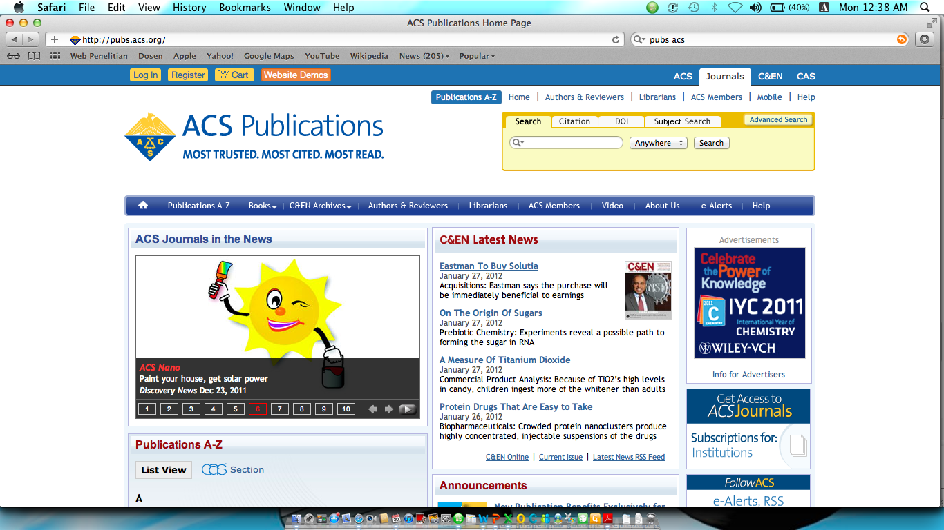
American Chemical Society

Slide 14
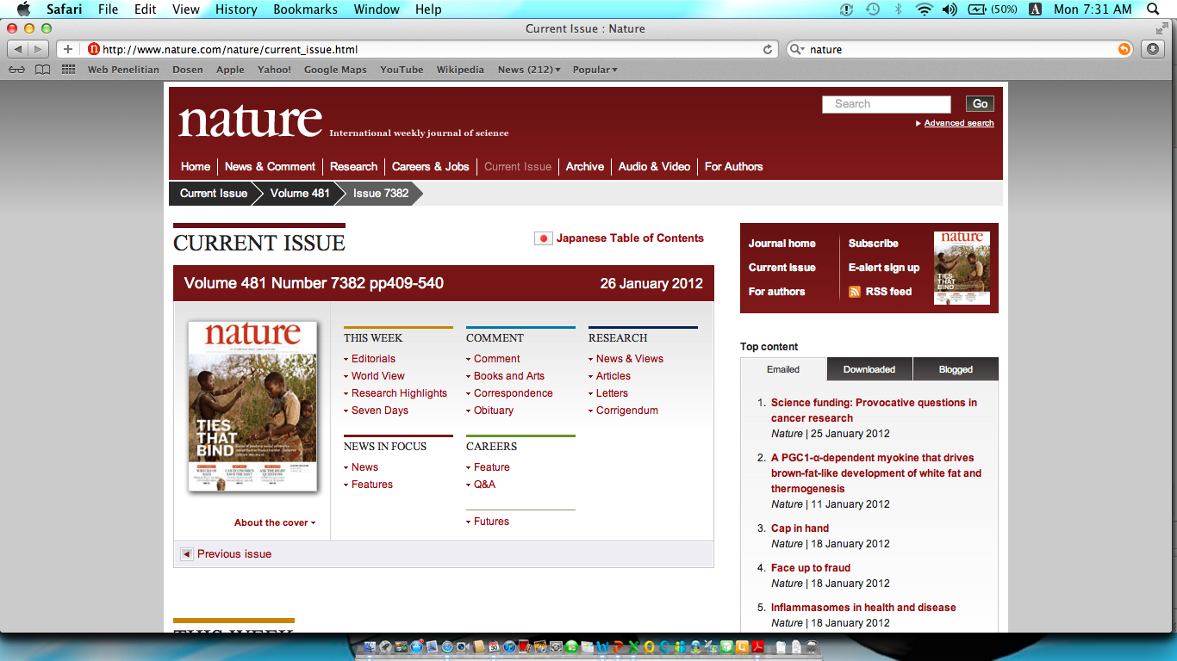
Nature

Slide 15
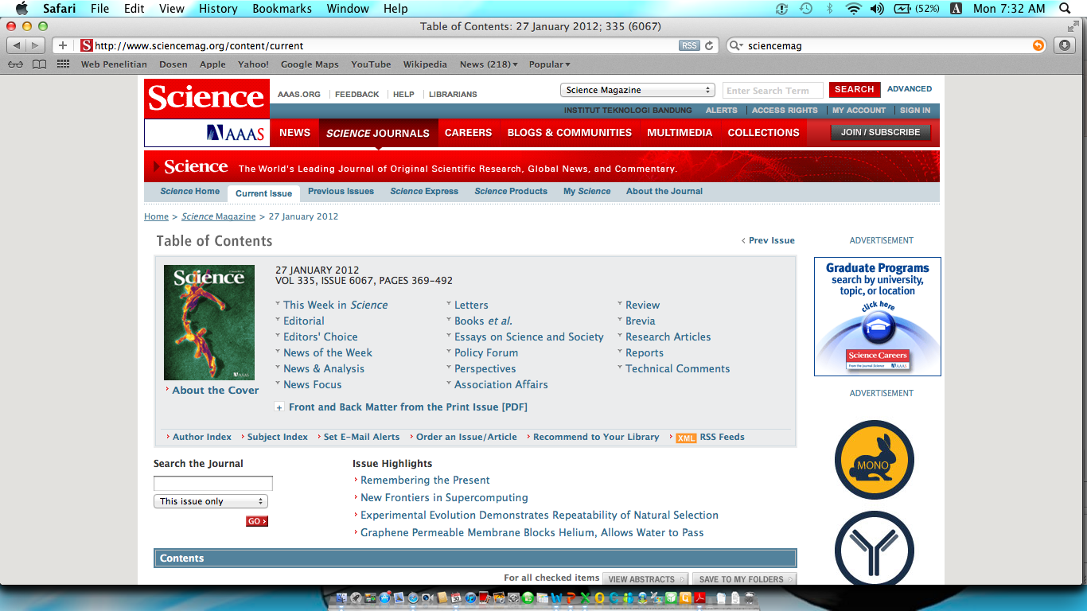
Science

Slide 16
Tips Memilih Jurnal Yang Tepat
Seleksi artikel dalam sebuah Jurnal harus melewati proses peer-review.
Jurnal harus terindeks sebuah metriks.
  (Scopus / Web of Science / SciFinder / SCImago)
Jurnal memiliki nilai impact factor (IF) yang baik.
Jurnal tidak termasuk dalam Beall’s list.

Slide 17
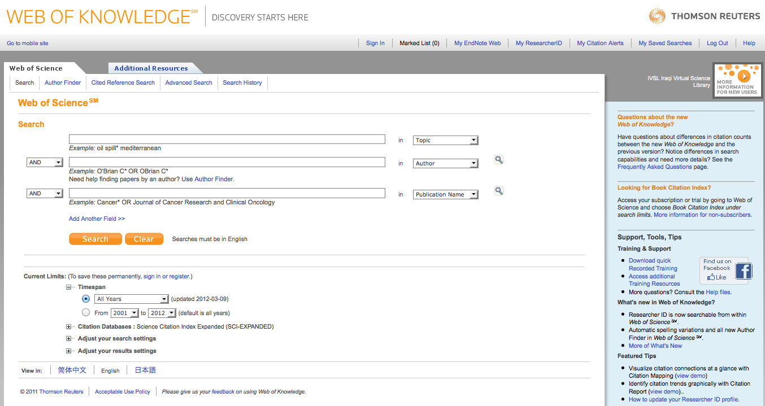

Slide 18
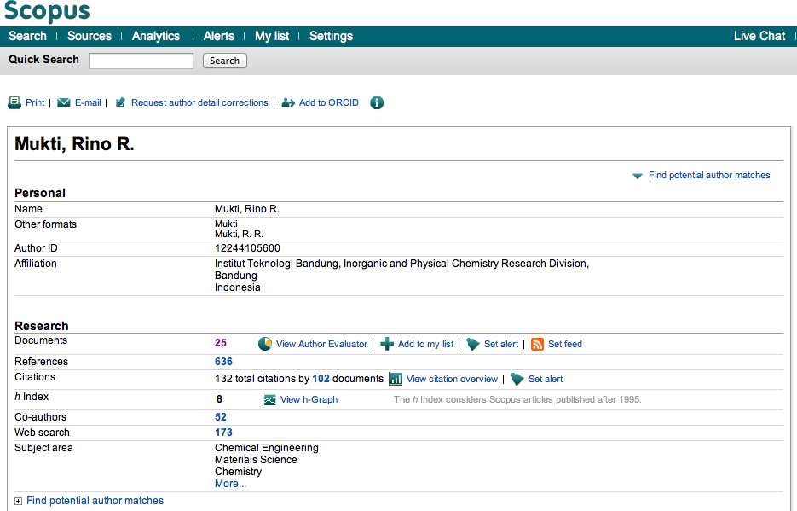
Setiap Publikasi Direkam Dalam Database Saintifik

Slide 19
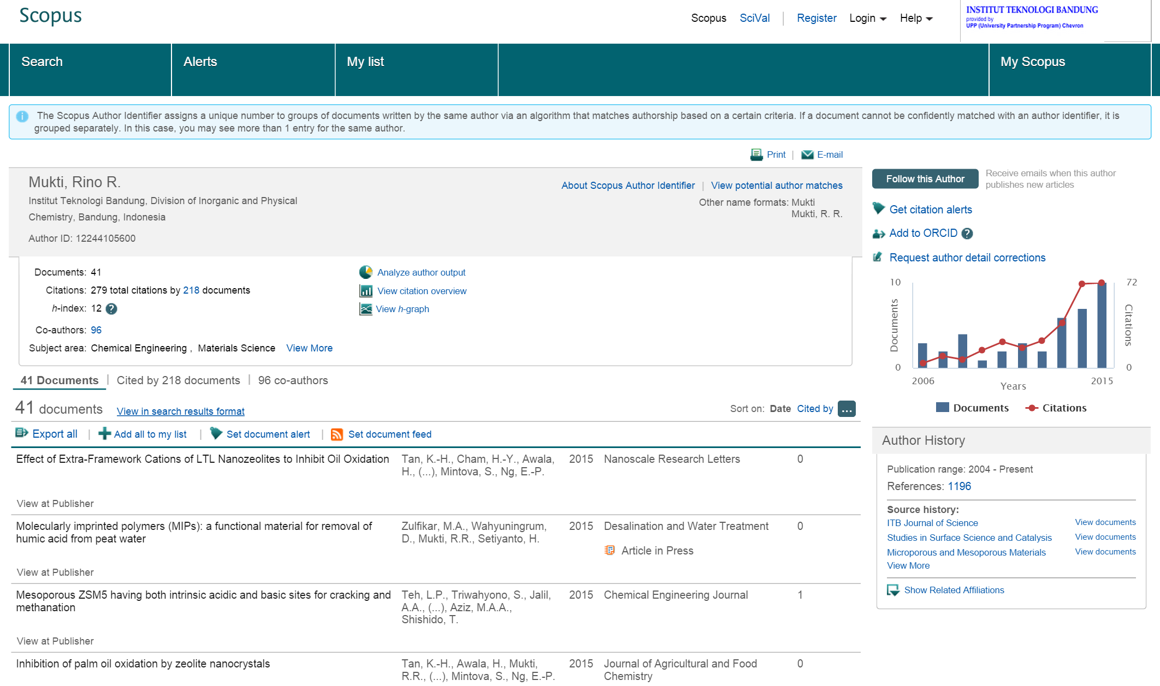
Setiap Publikasi Direkam Dalam Database Saintifik

Slide 20
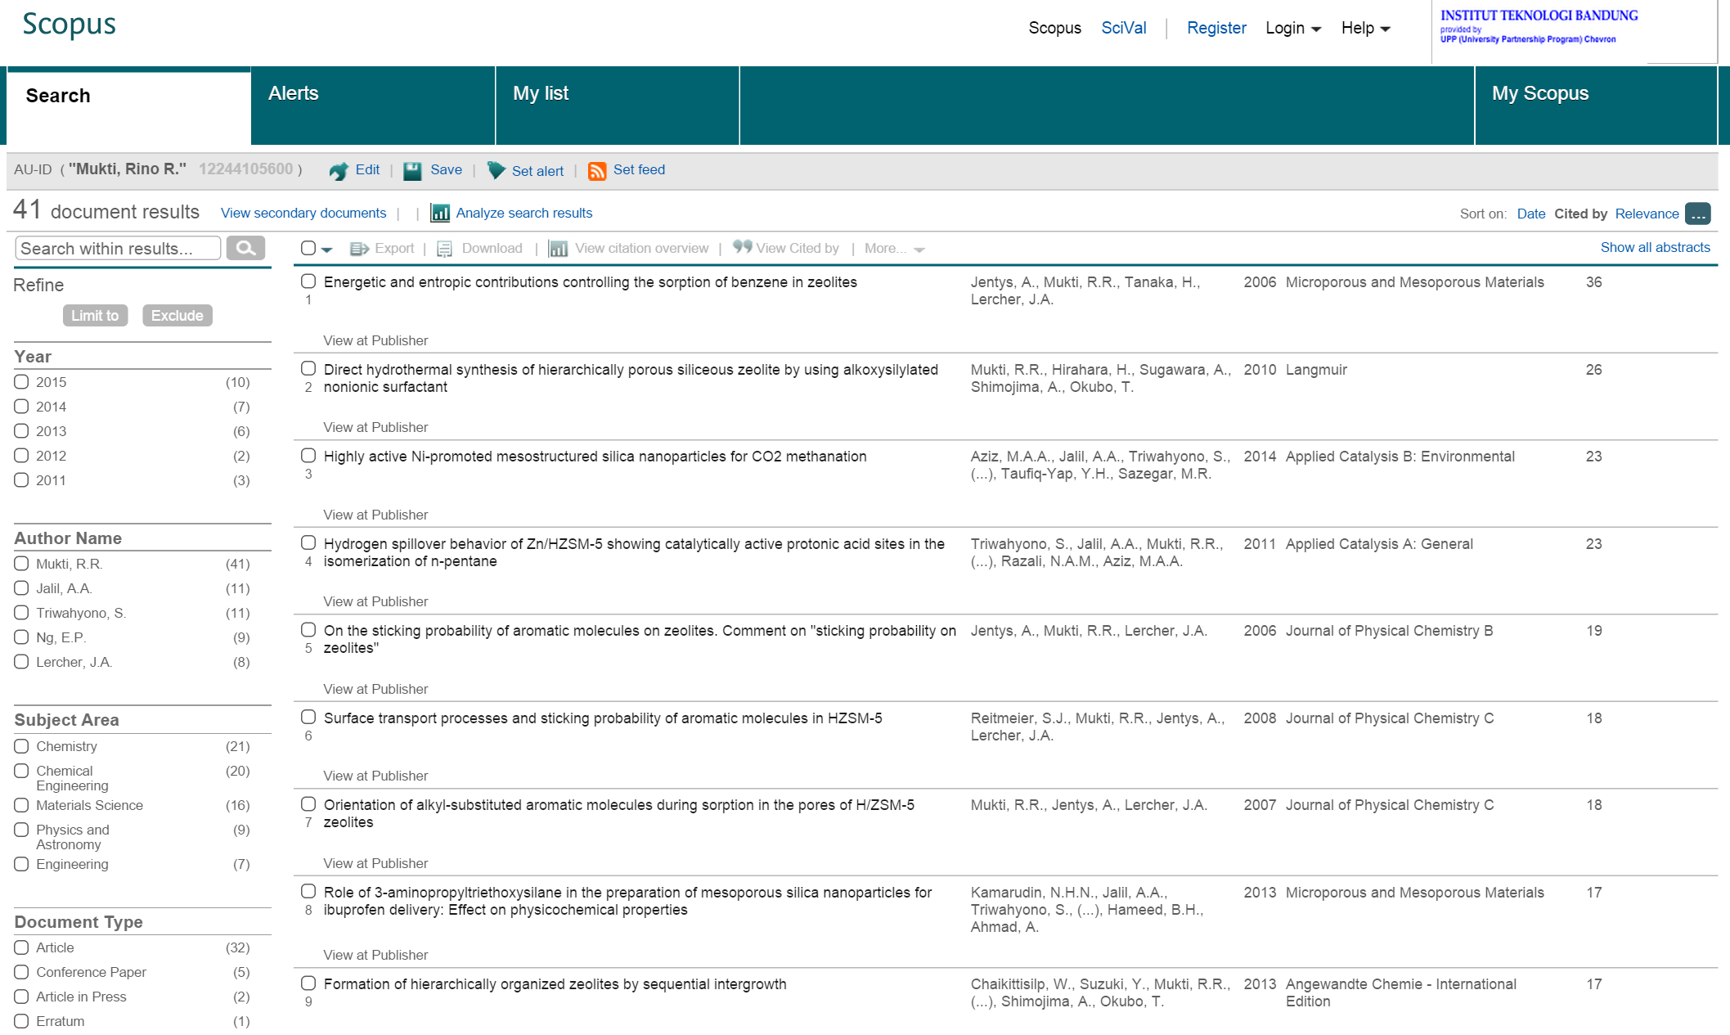
Daftar Publikasi Dan Rujukan (Citation)

Slide 21
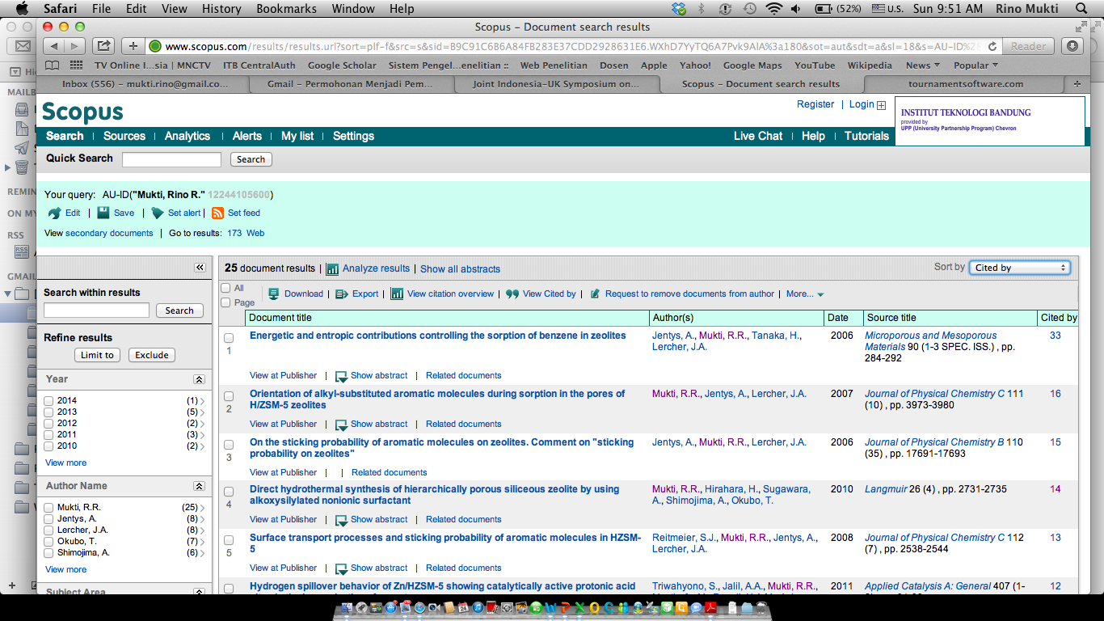
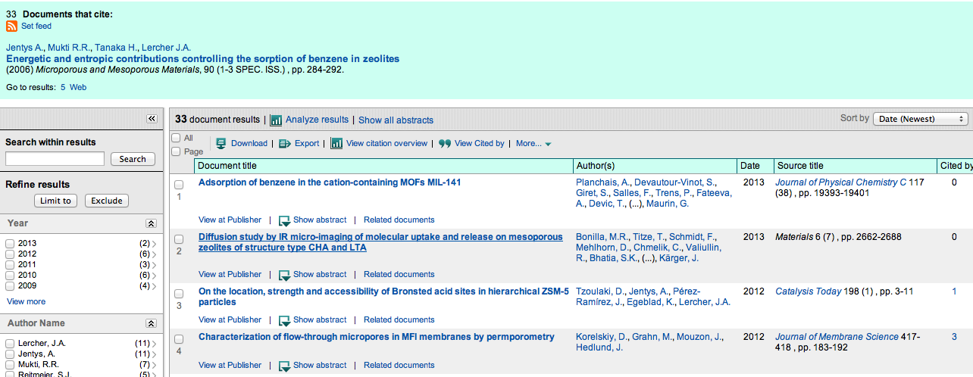

Slide 22
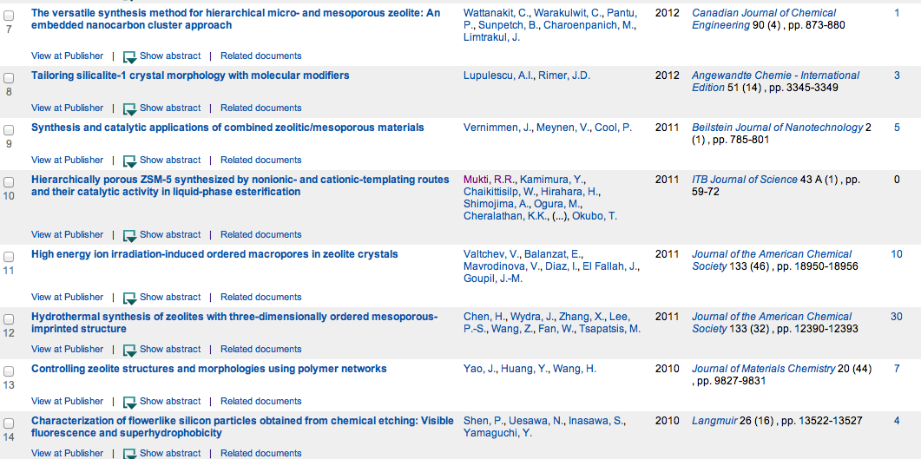
Dirujuk Jurnal Terkenal

Slide 23

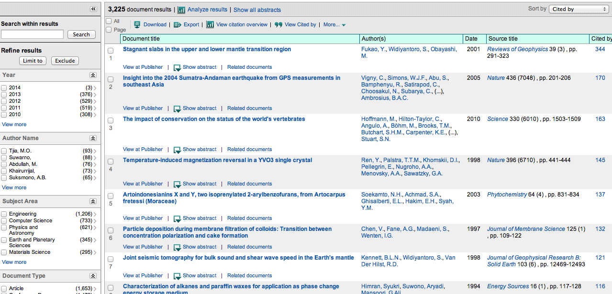

Slide 24
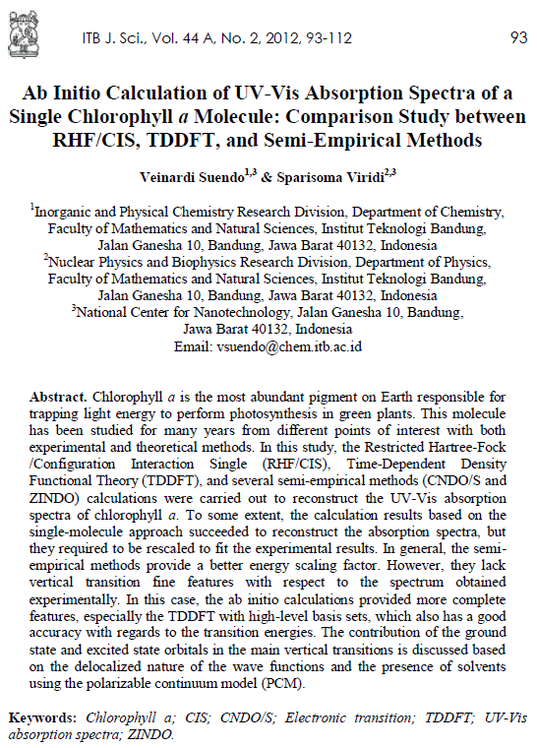




Cited by Renowned Journals
An article by Dr. Veinardi Suendo published on ITB Journal of Science in 2012 received 9 citations (up to Oct 30th 2016) from several renowned journals such as ACS journals, RSC journals, Elsevier Journals and Taylor & Francis Journals.

Slide 25
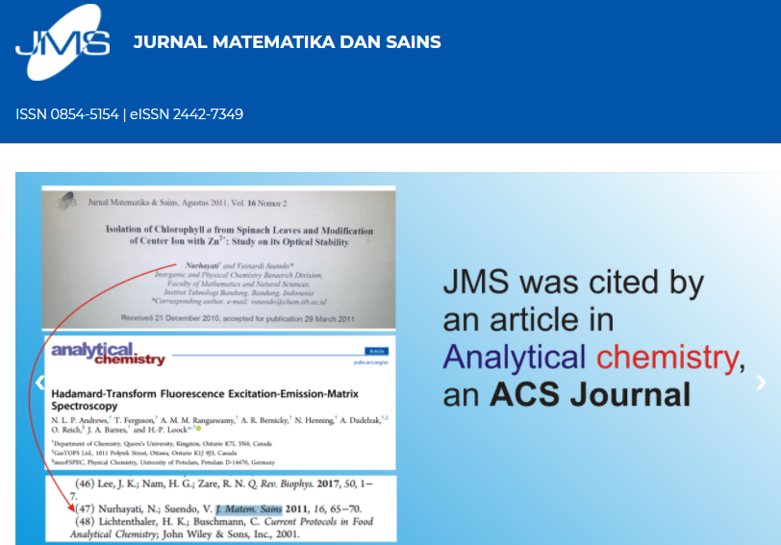
Cited by Renowned Journals

Slide 26
Types of Research Measures
Existing metrics focus on short term citation value
  Journal → Impact factor
  Article → Cited-half life
  Author → h-index

Slide 27
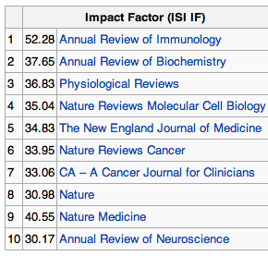
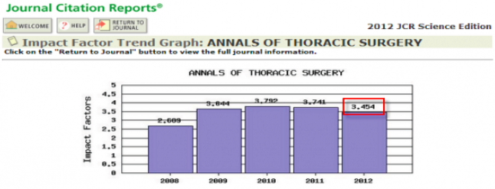
Journal Impact Factor
Jumlah Rujukan
IF =
Jumlah Artikel yang Diterbitkan sebuah Jurnal

Slide 28
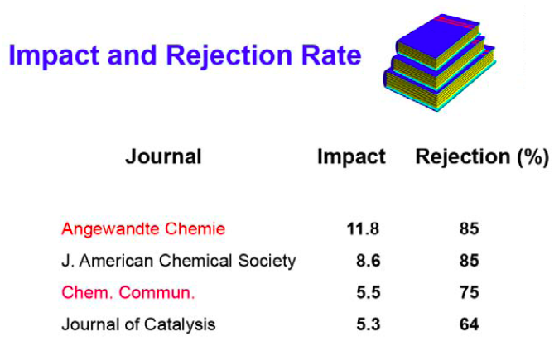

Slide 29


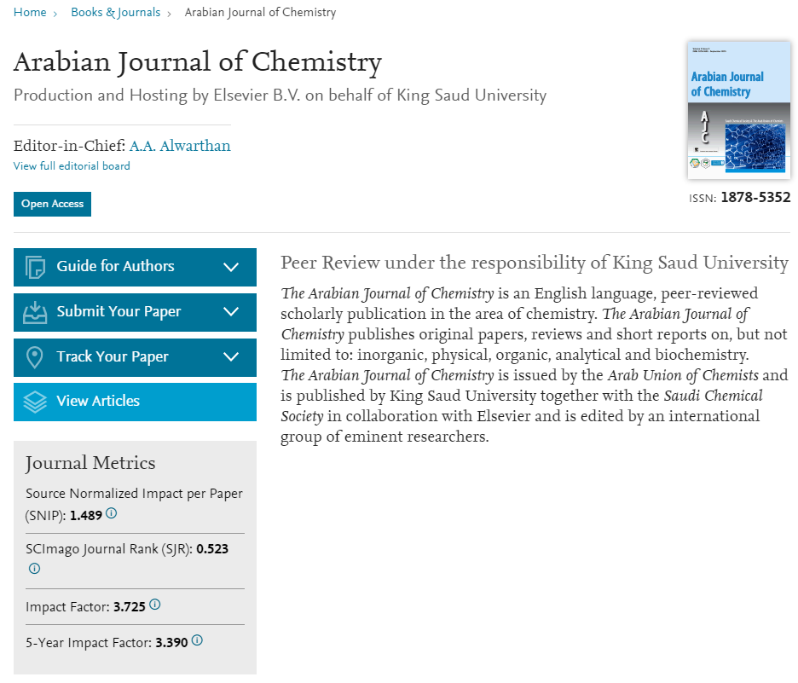
Memilih Jurnal berdasarkan IF ?

Slide 30
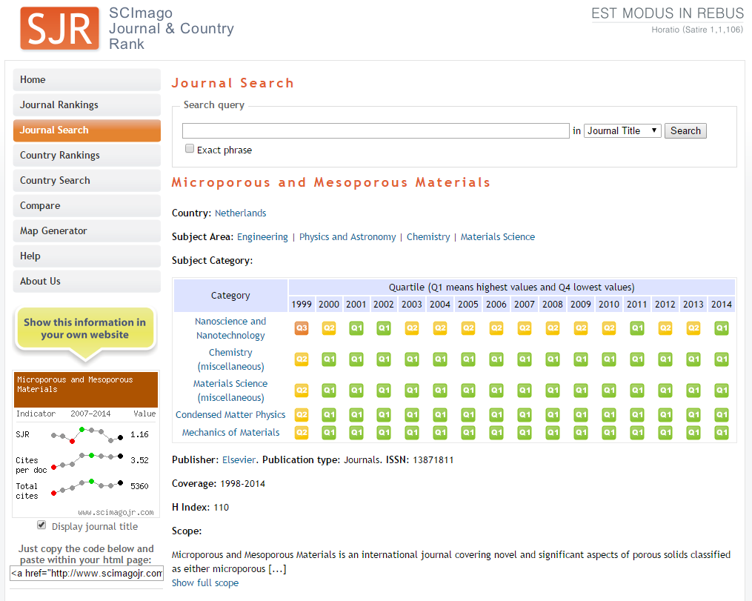

Slide 31
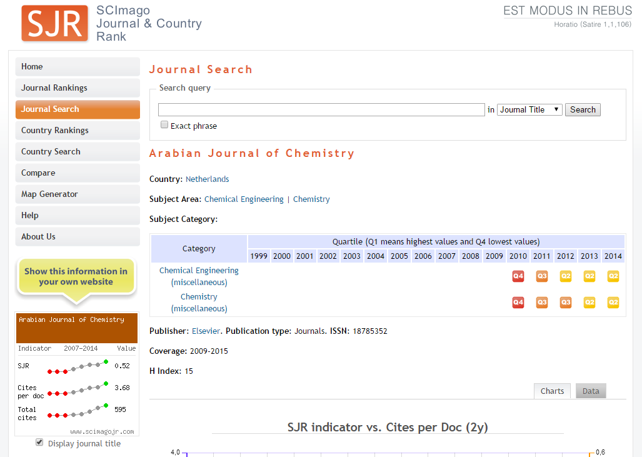

Slide 32
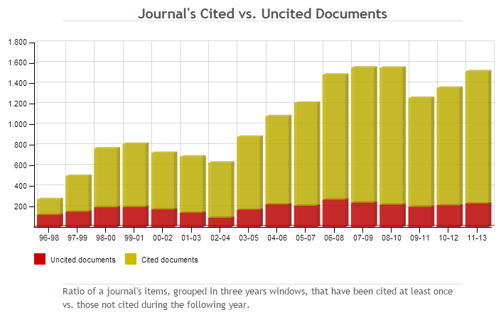
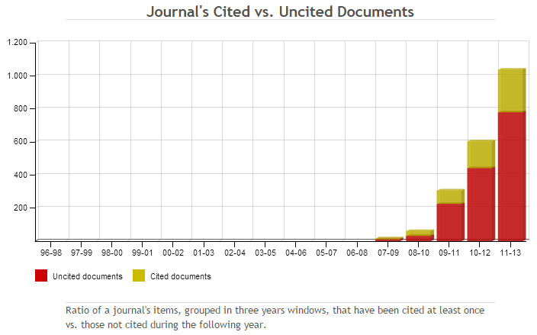

Slide 33
Types of Research Measures
Existing metrics focus on short term citation value
  Journal → Impact factor
  Article → Cited-half life
  Author → h-index

Slide 34
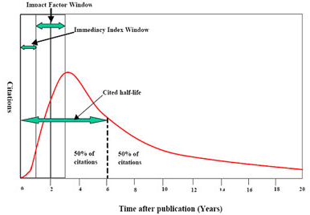
Kurva Sitasi
Ukuran seberapa cepat, sering dan lama

Slide 35
Types of Research Measures
Existing metrics focus on short term citation value
  Journal → Impact factor
  Article → Cited-half life
  Author → h-index
A scientist has index h if h of his papers have at least h citations each and the other papers have no more than h citations each.
Eg.: Prof. XYZ has index 14 if 14 of his papers have at least 14 citations each and the other papers have no more than 14 citations each.

Slide 36
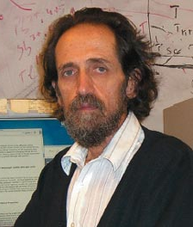
h-index in Scopus
Developed in 2005 by Jorge Hirsch, a condensed-matter physicist (University of California in San Diego) and peace activist.

Slide 37
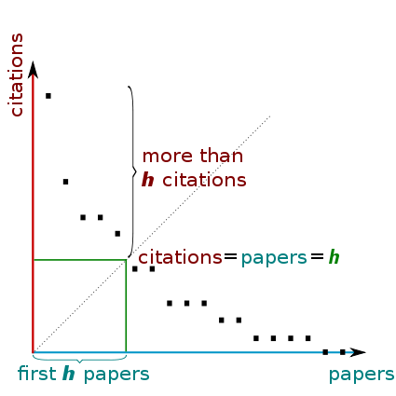
h-index Author
Contoh
h-index = 15
Setidaknya 15 paper dengan citation minimal 15

Slide 38
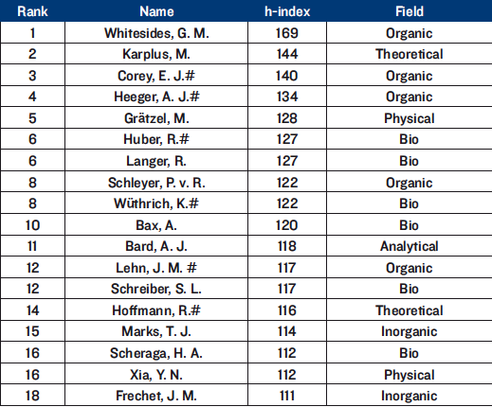
Ranking h-index

Slide 39
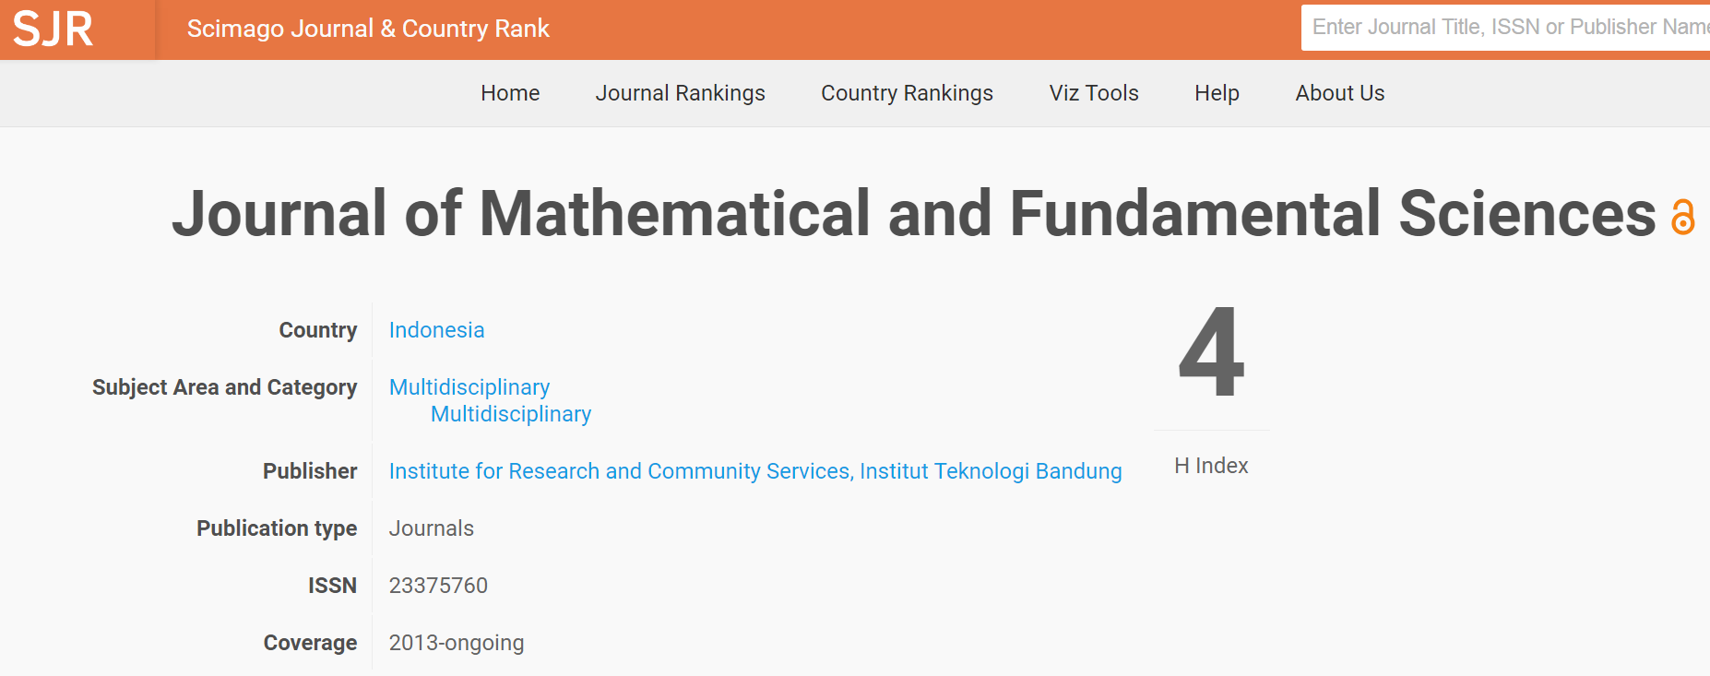
h-index Jurnal

Slide 40
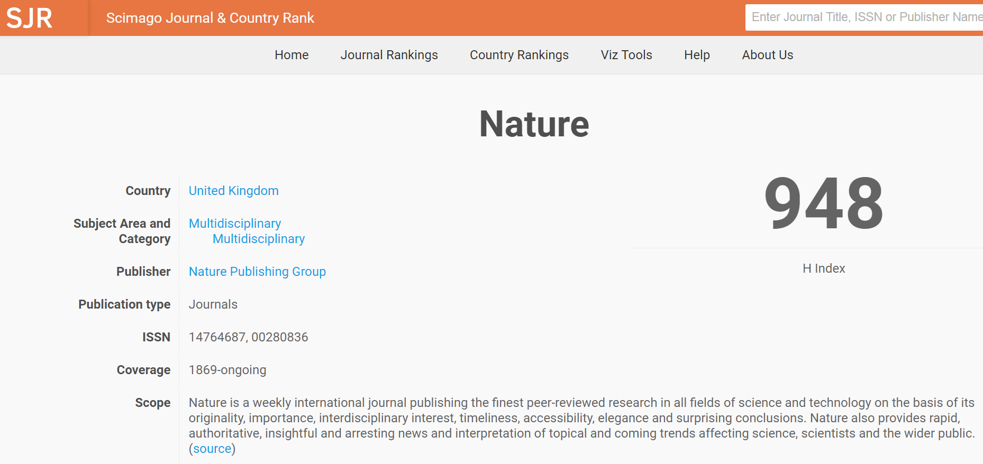
h-index Jurnal

Slide 41
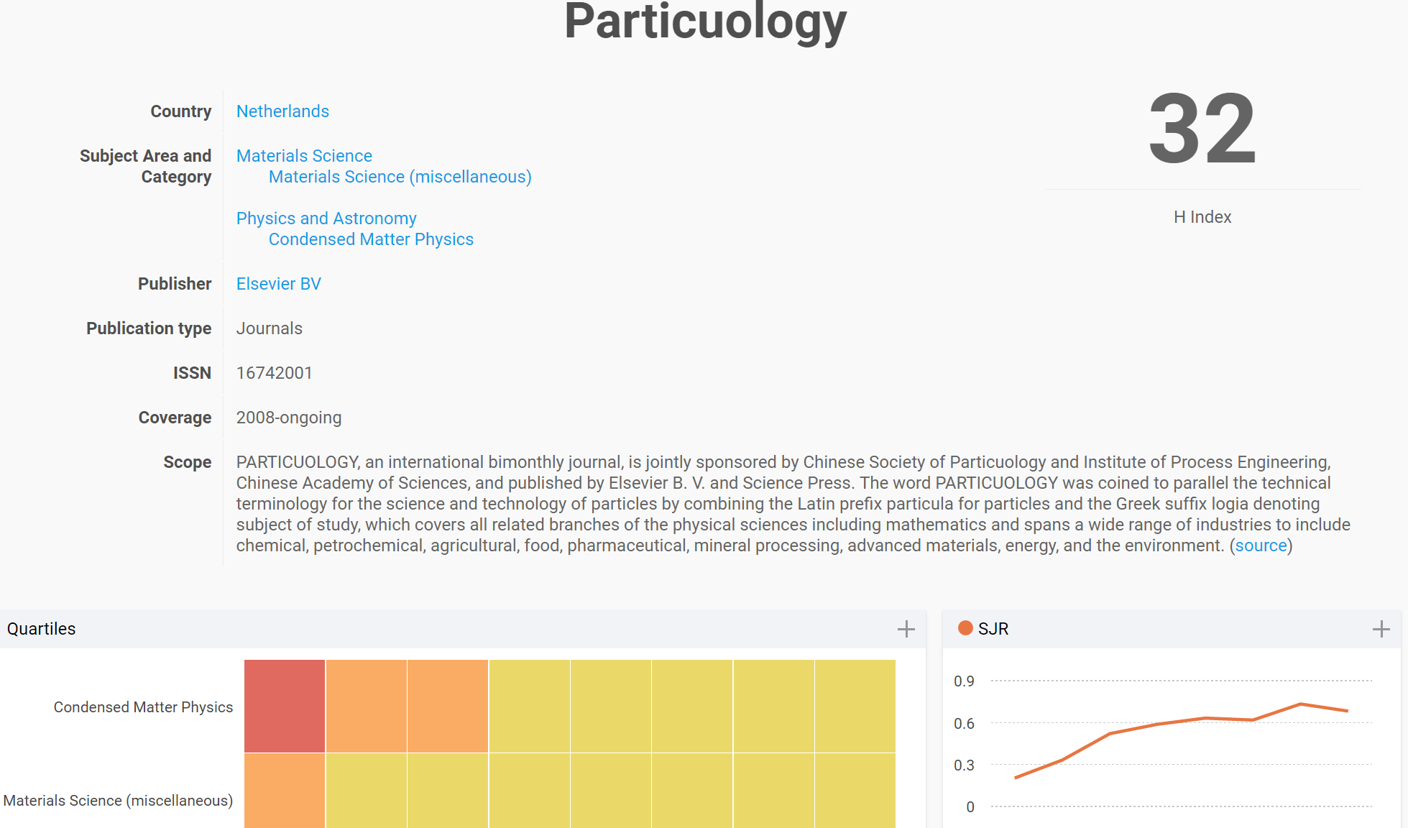
Jurnal dengan orde h-indeks jurnal ratusan (10²)
Q2
Q2

Slide 42
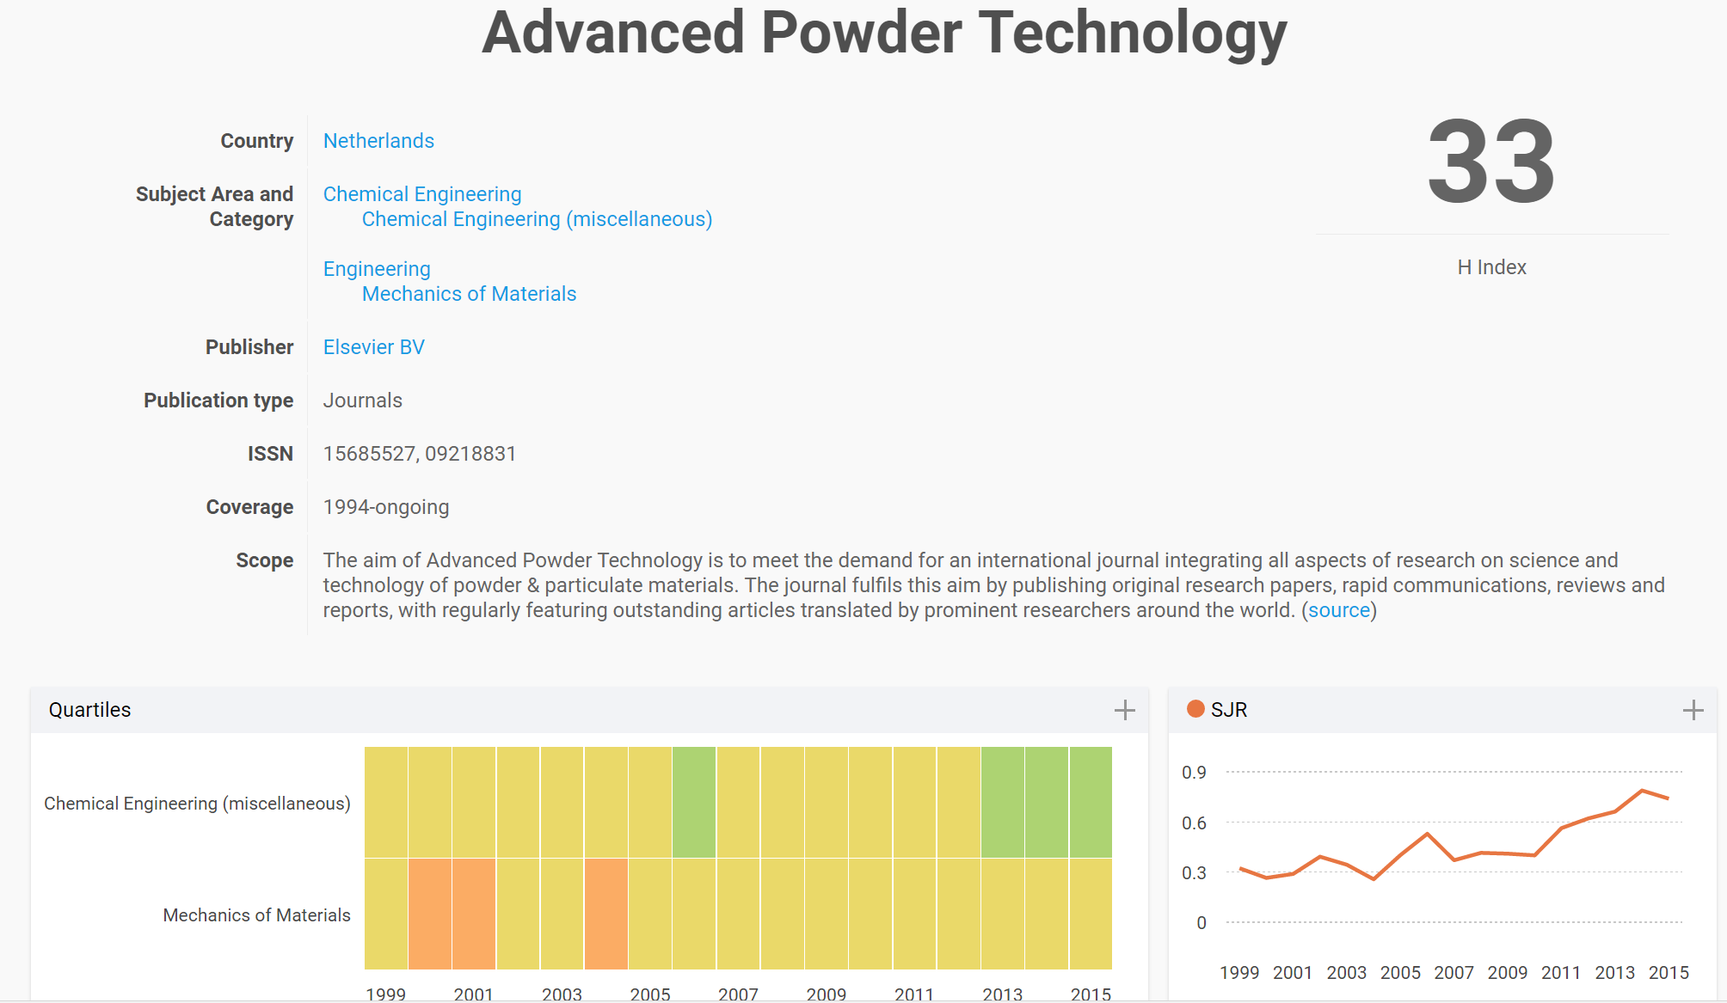
Jurnal dengan orde h-indeks jurnal ratusan (10²)
Q1
Q2

Slide 43
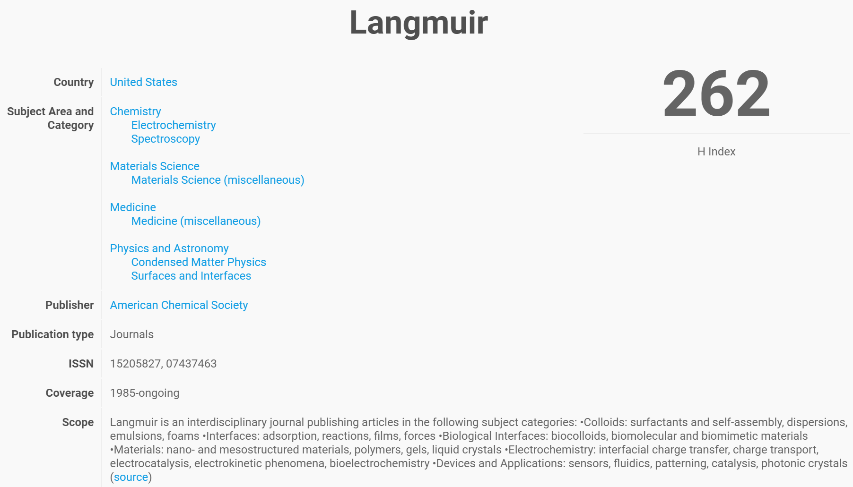
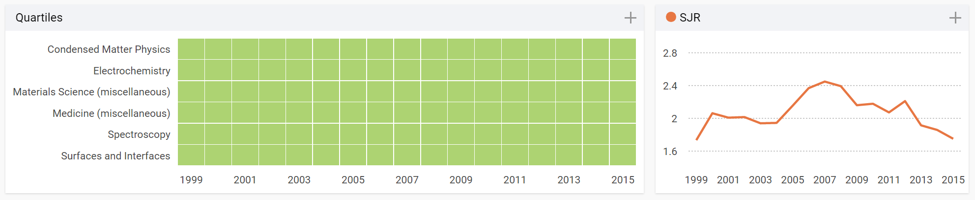
Q1

Slide 44
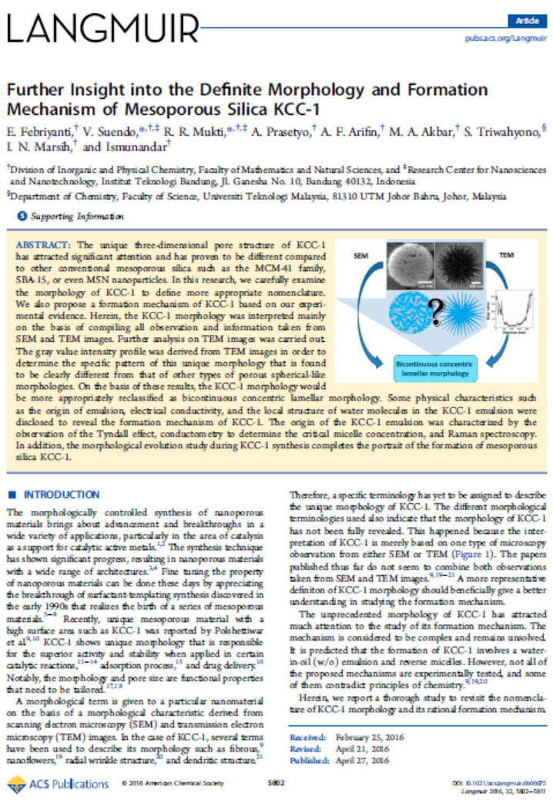

Slide 45
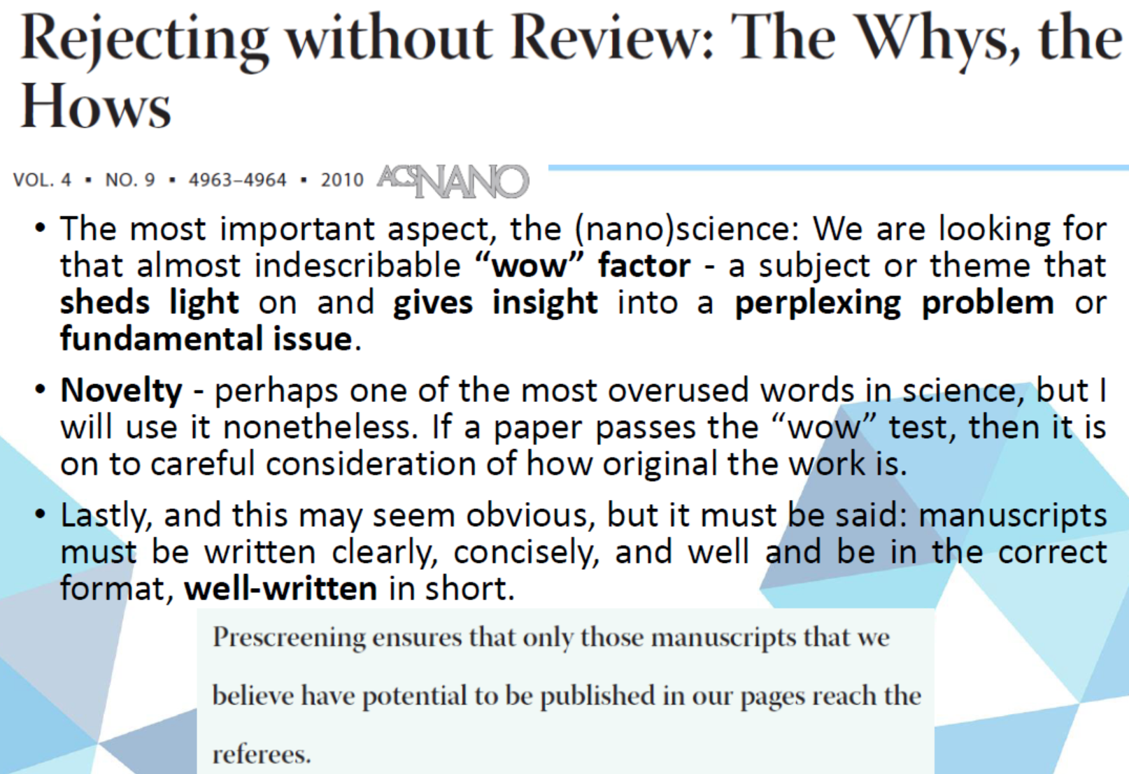
Important Factors on Writing Papers: Wow factor, Novelty and Well-written

Slide 46
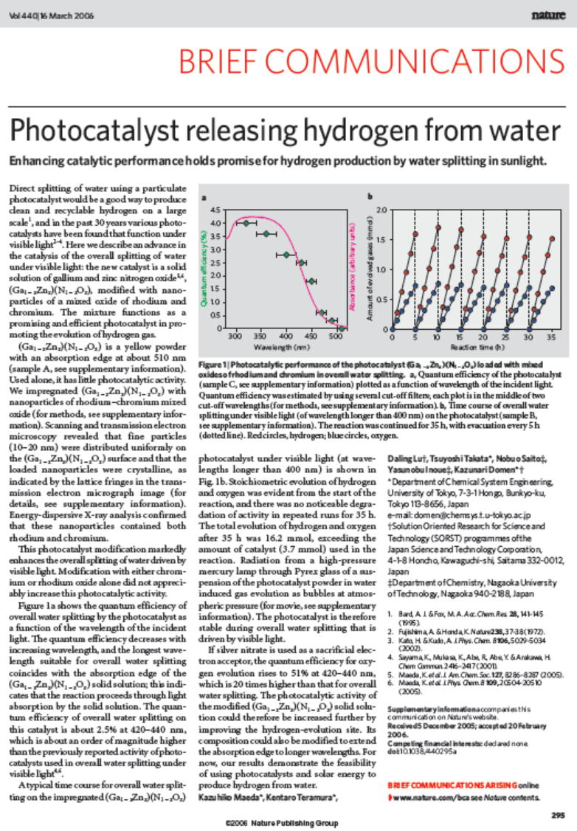

Slide 47
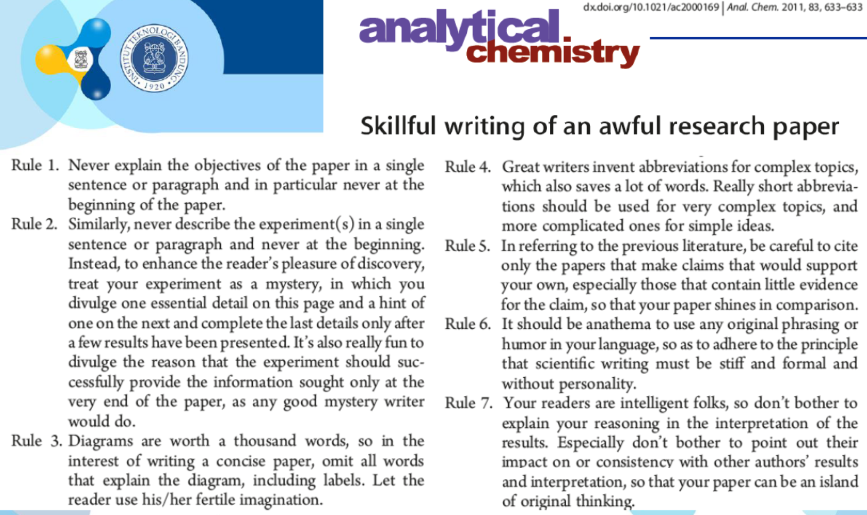
Skillfull writing of an awful research paper

Slide 48
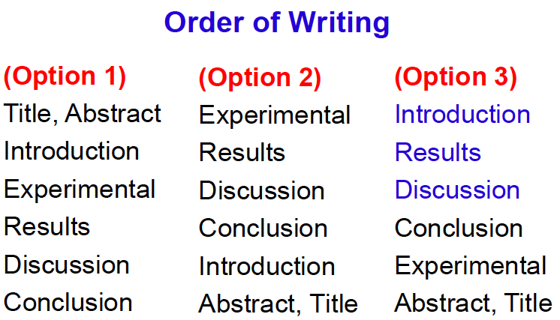

Slide 49
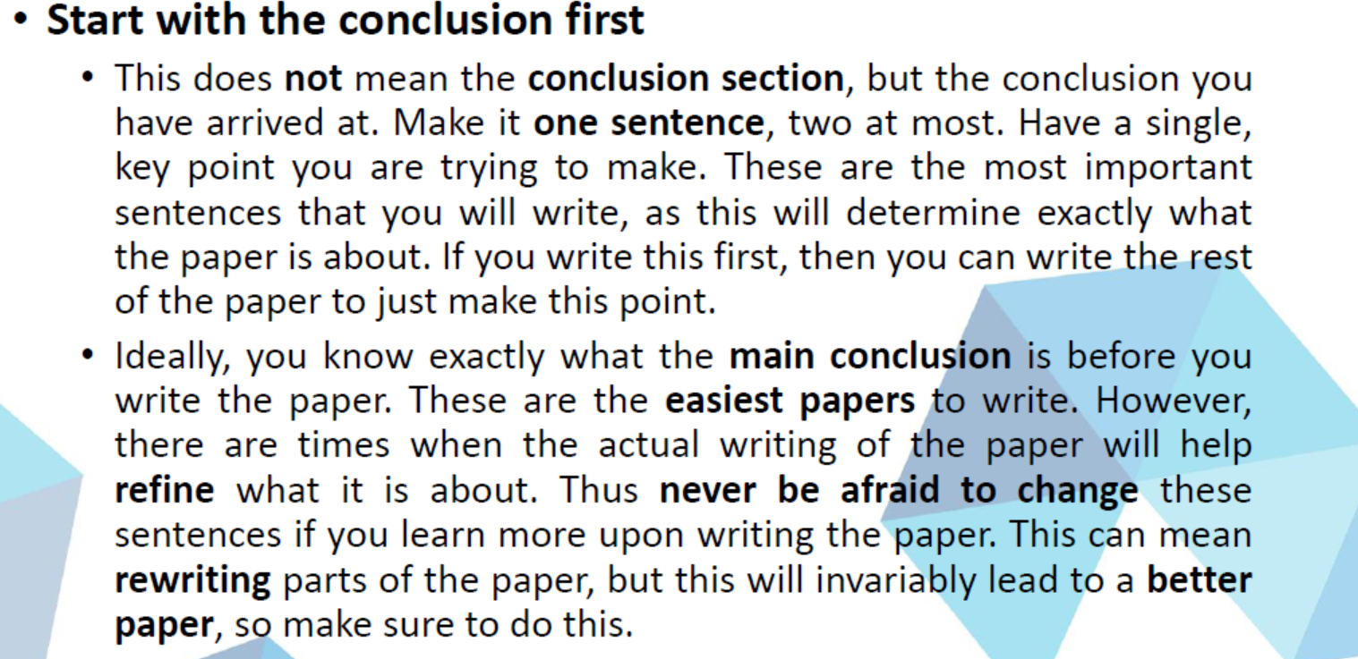
Option 4

Slide 50
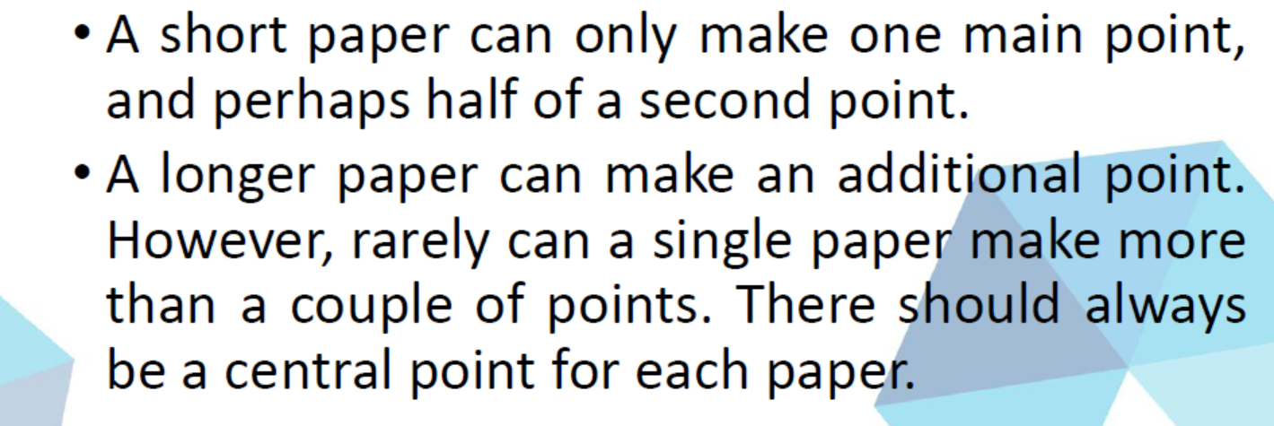
Choosing Letter type of Paper or Full Paper

Slide 51
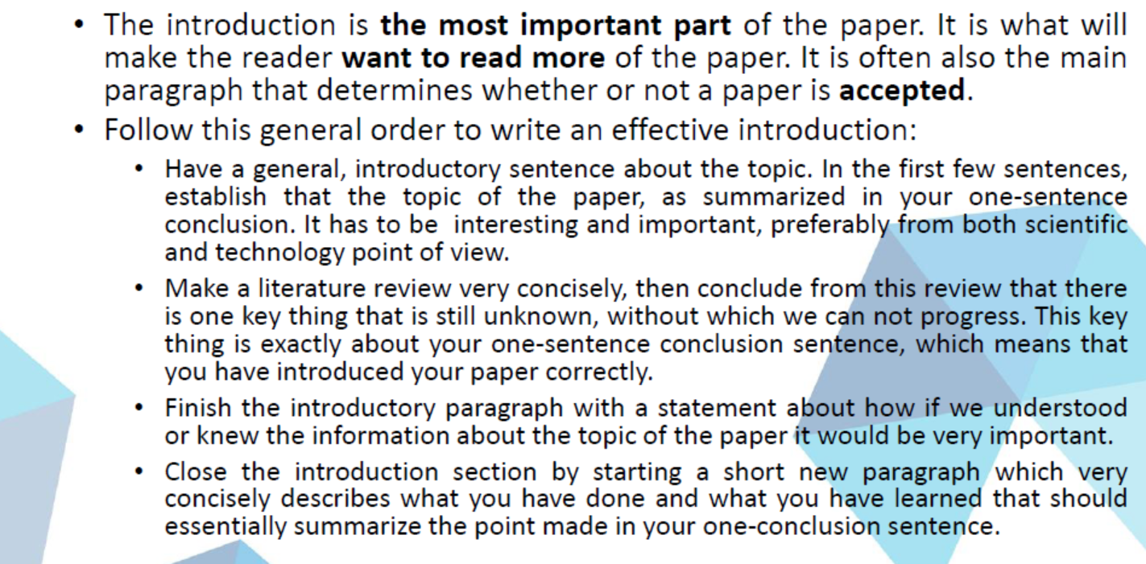
Guide to write introduction

Slide 52
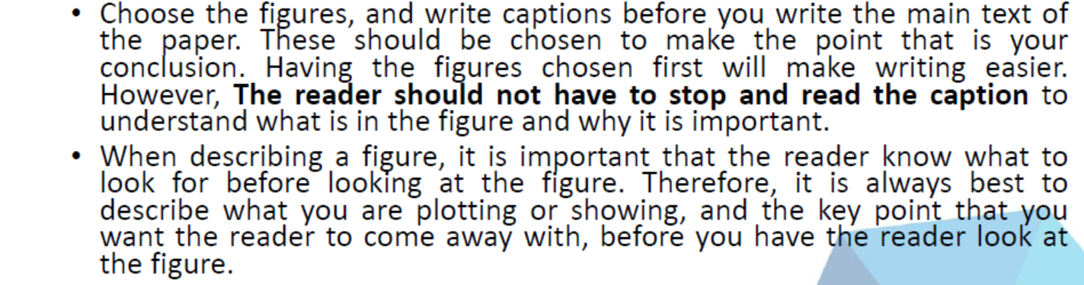



Guide to present Figures

Slide 53

Choosing the right paper title
Submitted on Chemistry Letters

Slide 54
Choosing the right paper title
Decision from Chemistry Letters Editorial
Reviewer #1
Reviewer #2

Slide 55
Choosing the right paper title
Submitted on Microporous and Mesoporous Materials

Slide 56
Choosing the right paper title
Decision from Microporous and Mesoporous Materials Editorial
Reviewer #1
Reviewer #2
Editor

Slide 57
Choosing the right paper title
Submitted on Journal of Material Science

Slide 58
Choosing the right paper title
Decision from Journal of Material Science Editorial

Slide 59

Choosing the right paper title (Successfully Published)

Slide 60
Types of Scientific Articles
Short Communication or Letter
Full Paper
Review
Comment Article

Slide 61
Disputed comment found on journal

Slide 62

Example: Comment

Slide 63

Example: Reply Comment

Slide 64

Example: Full Paper

Slide 65

Example: Letter

Slide 66

Example: Letter

Slide 67

Example: Letter

Slide 68

Example: Review

Slide 69

Example: Review

Slide 70


Slide 71

Example: Review

Slide 72

Example: Chapter Book

Slide 73
Reviewing Process
Transparant:
  Reviewer disclosed.
  Author disclosed.
Single blind:
  Reviewer undisclosed.
Double blind:
  Reviewer undisclosed.
  Author undisclosed.
  Triple Blind ?

Slide 74


Slide 75


Slide 76
Beall’s list
Abhinav
A M Publishers
Academe Research Journals
Academia Publishing
Academic and Business Research Institute
Academic Journals
Academic Journals and Research ACJAR
Academic Journals, Inc.
Academic Journals Online (AJO)
Academic Publications, Ltd.
Academic Research Publishing Agency
Academic Sciences
Academy & Industry Research Collaboration Center(AIRCC)
Academy Journals
Academy of Knowledge Process
Academy of Science and Engineering (ASE)
Academy Publish
Access International Journals
Ada Lovelace Publications
Advanced Research Journals

Slide 77
What makes a journal predatory
The journal is not indexed by a major database (e.g. Scopus, DOAJ, JCR, etc)
The impact factor mentioned is no the correct one listed in JCR (Journal Citation Reports, by Thomson Reuters).
The Editor or the editorial board members are not from the correct field of study. You do not recognize any of the names on the Editorial Board.
The mechanism of peer review for the journal is not clearly stated and do the terms of publications appear too good to be true
The article processing charges (APCs) are not clearly stated? The website appears to be overly concerned about the payment of fees.
The journal or published send unwanted e-mails to you event though you have asked them to stop. The emails are not written professionally.
You cannot easily identify or contact the publisher. The telephone number, address or email appears incorrect or is not functioning.

Slide 78

Summary

